Slide 1
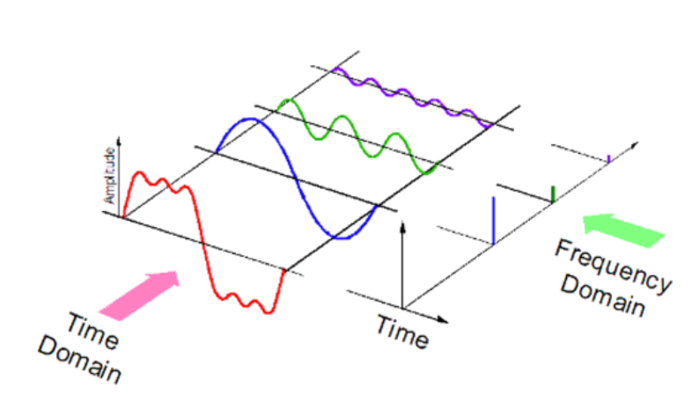
Fourier Transform
Week 1
K220001 Sumaiyah Zahid

Slide 2
The Fourier Transform changes our perspective
from consumer to producer
turning What do I have? Into How was it made?

Slide 3
What does the Fourier Transform do?
Given a smoothie, it finds the recipe.
Given an image, it finds its frequency components.

Slide 4
Fourier Transform
The Fourier Transform takes a time-based pattern, measures every possible cycle, and returns the overall "cycle recipe" (the amplitude, offset, & rotation speed for every cycle that was found).
Spatial Domain
Fourier Transform
Frequency Domain

Slide 5
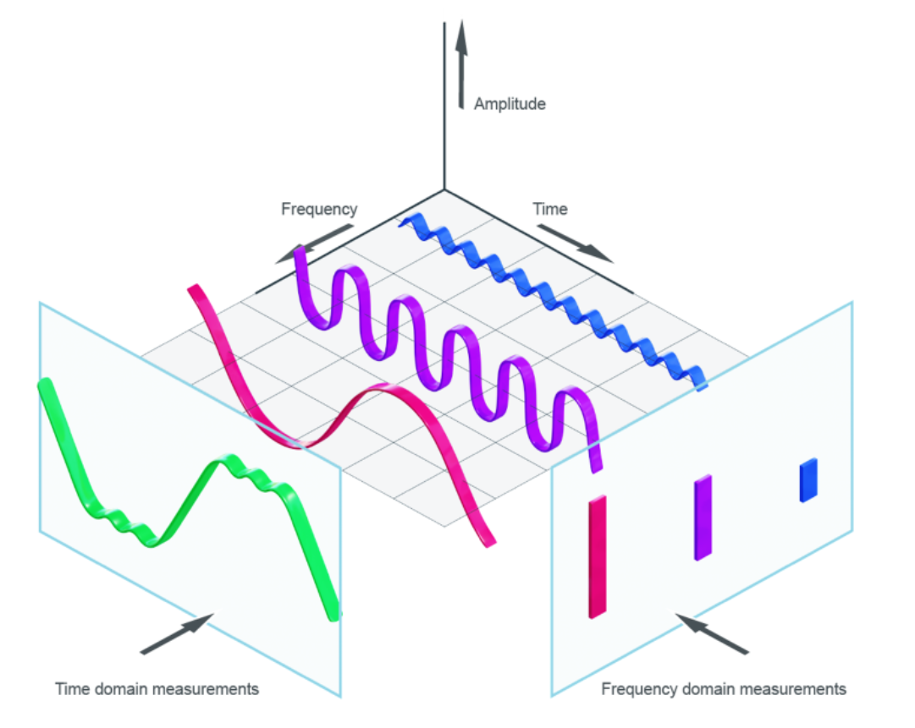
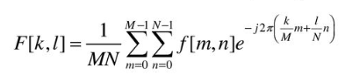
Image & Fourier Transform
Image is a 2D discrete signal
So we use 2D Discrete Fourier Transform (DFT)

Slide 6
Why Fourier Transform?
Recipes are easier to analyze, compare, and modify than the smoothie itself.
Given an image, image filtering, noise removal, image reconstruction, image compression in frequency domain is much simpler than in spatial domain.

Slide 7
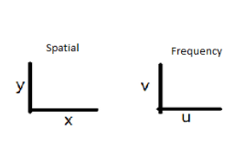
Fourier Transform
As a function of time, the pixels per image change.
In frequency domain, we compare and contrast the rate at which pixels are transformed over an environment.

Slide 8
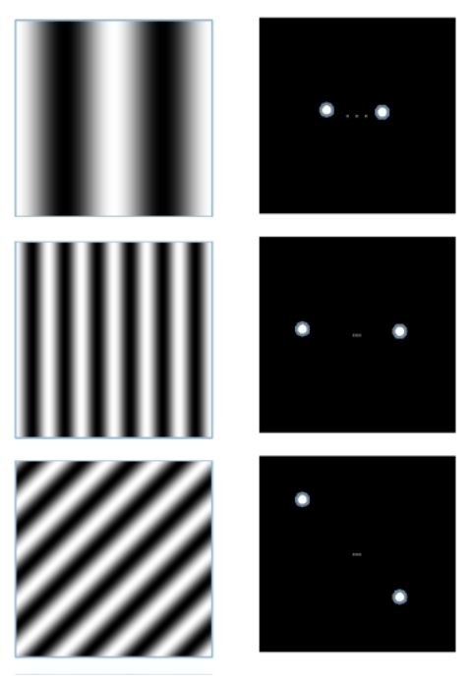

Slide 9
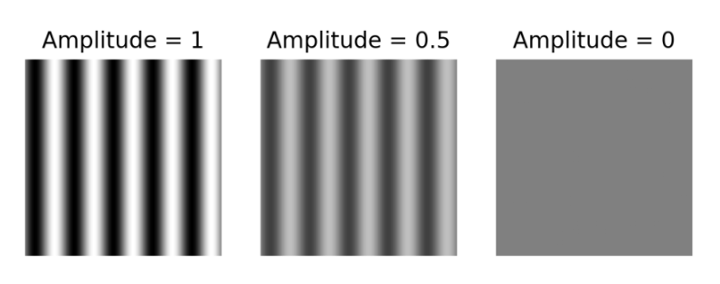
Fourier Transform
The amplitude is also referred to as contrast, determines the difference in grayscale values between the maximum and minimum points of a grating.

Slide 10
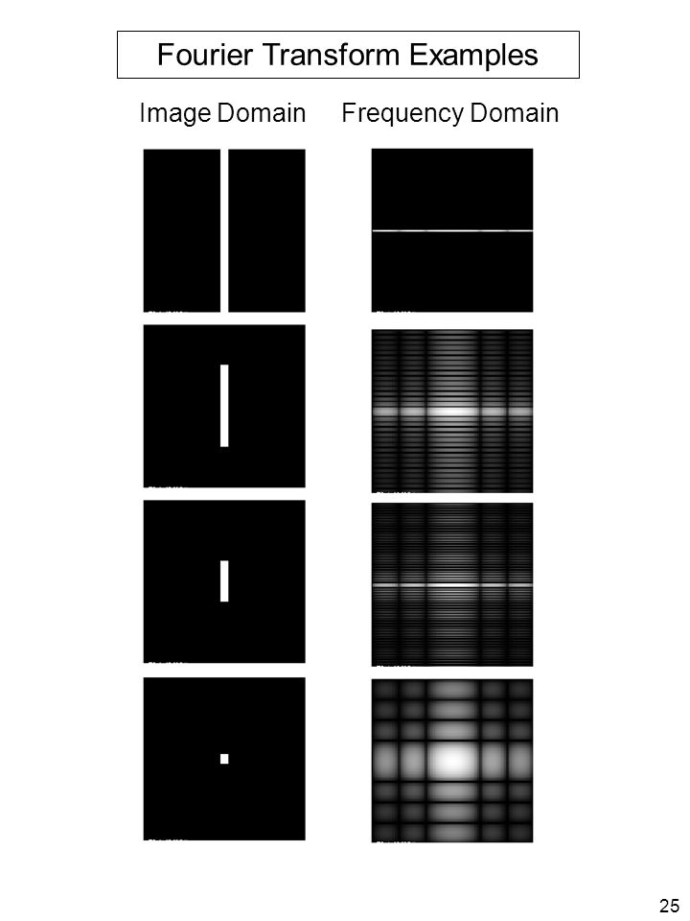

Slide 11
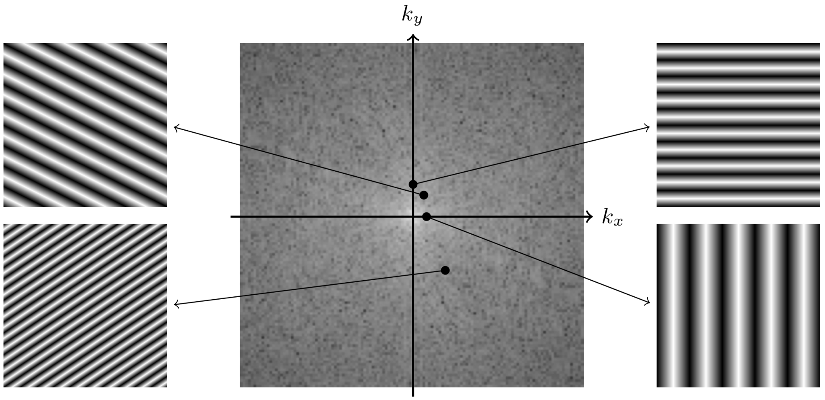

Slide 12
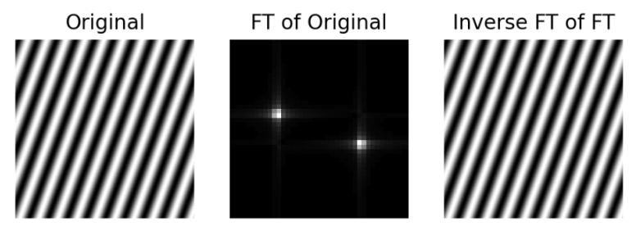
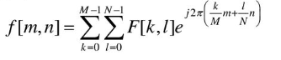
How do we get the smoothie back?
Blend the ingredients.
Inverse Fourier Transform

Slide 13
Applications
Noise Removal
Image filtering
Image reconstruction
Image compression

Slide 14
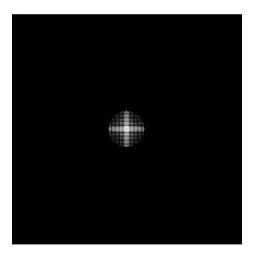
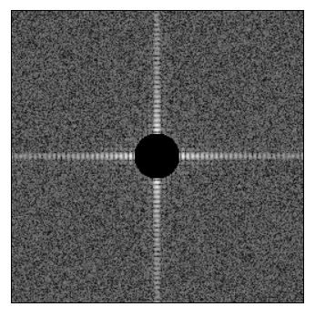
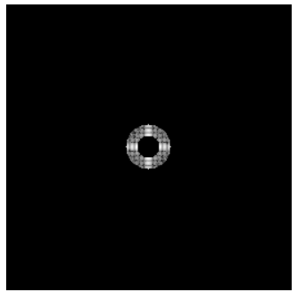
Image Filtering

Slide 15
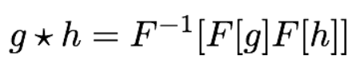
Image Filtering
Convolution in spatial domain is equivalent to multiplication in frequency domain:

Slide 16
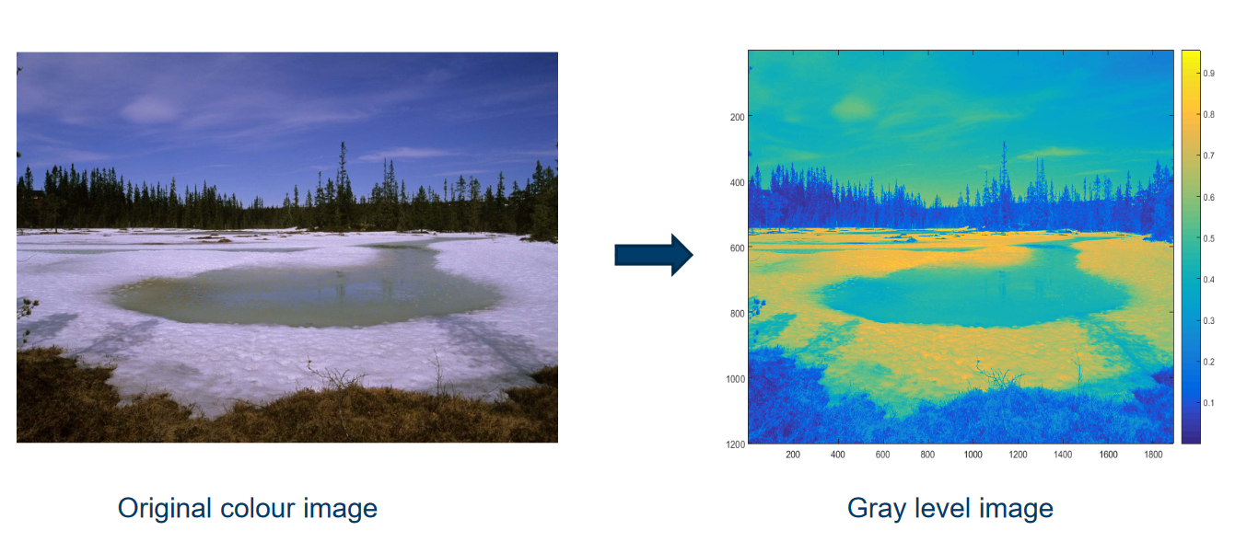
Image Filtering

Slide 17
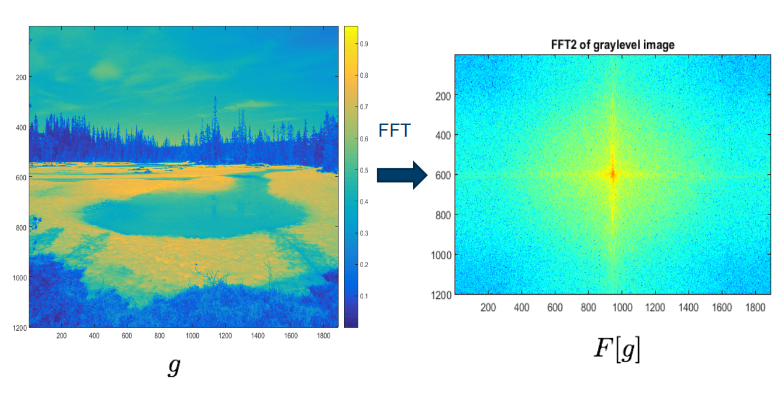
Image Filtering

Slide 18
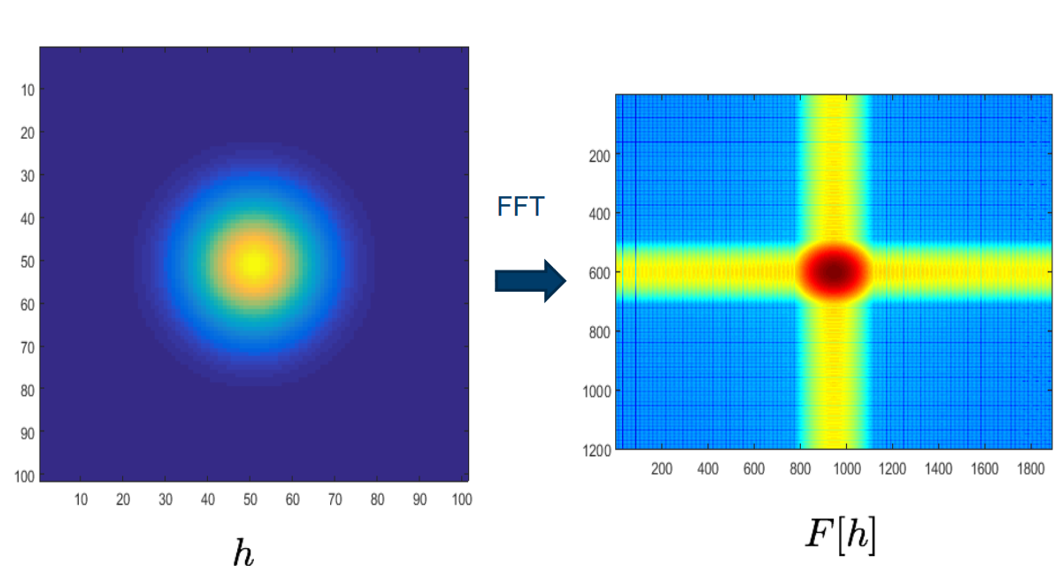
Image Filtering

Slide 19
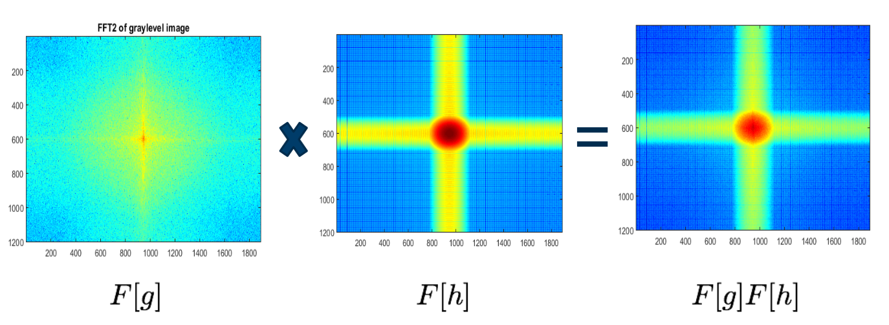
Image Filtering

Slide 20
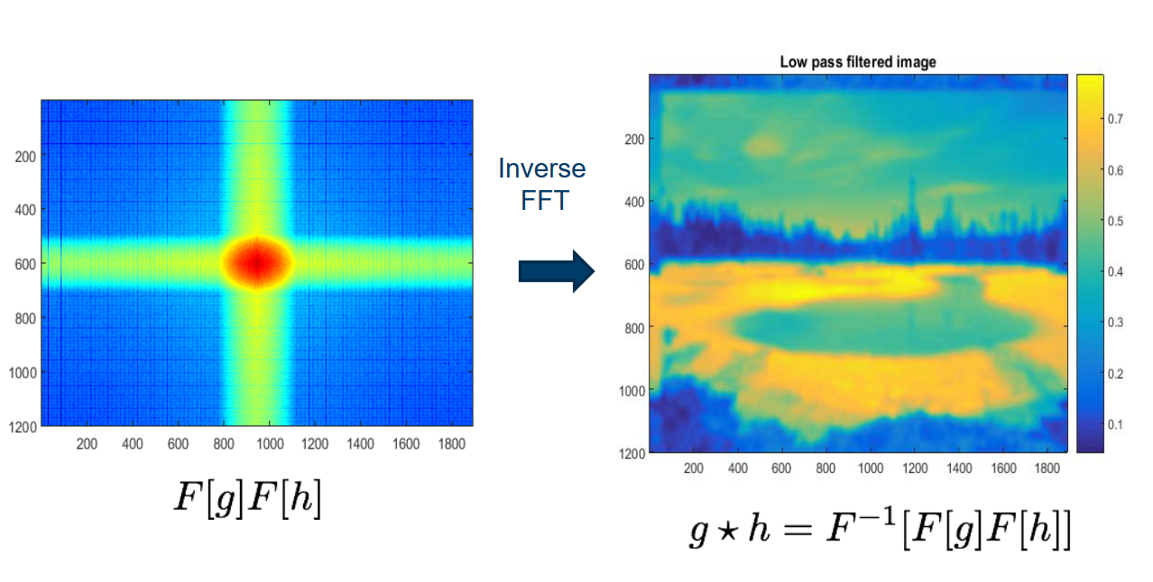
Image Filtering

Slide 21
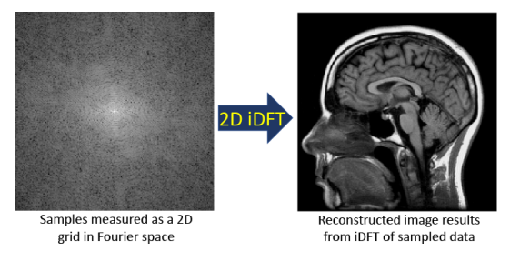
Image Reconstruction

Slide 22
Resources
https://www.uio.no/studier/emner/matnat/its/nedlagte-emner/UNIK4690/v16/forelesninger/lecture_2_1_filtering.pdf
https://betterexplained.com/articles/an-interactive-guide-to-the-fourier-transform/
https://www.cs.unm.edu/~brayer/vision/fourier.html
https://regaladys.wordpress.com/2010/09/23/7-properties-of-the-2d-fourier-transform/
https://docs.opencv.org/4.x/de/dbc/tutorial_py_fourier_transform.html
https://homepages.inf.ed.ac.uk/rbf/HIPR2/fourier.htm

